Slide 1
Muscle fatigue evaluation using a EMG and accelerometer.
Guide: Dr. Shivaprakash G
Team members:
Aman Verma(1MS19EI003)
Chirag Sinha(1MS19EI014)
Gopal Tyagi(1MS19EI015)
Guru Manglam Siddhe(1MS19EI017)

Slide 2
Contents
Introduction
Literature Survey
Problem Statement
Functional Block Diagram
Conclusion
References

Slide 3
Problem Statement
One of the common problem we have during exercising is, we keep on working out without knowing the actual limitations of our body.
Often this leads to major injuries like muscle tears.
For this very problem we are proposing a solution in which we will tell the person to stop the exercise when the person reaches a specified level of fatigue.

Slide 4
Literature Survey
Sl.No | Reference paper | Contribution
1 | M. Ayaz, M. W. Ayub and I. A. Qureshi, "Arduino Based Fatigue Level Measurement in Muscular Activity using RMS Technique," 2020 International Conference on e-Health and Bioengineering (EHB), 2020, pp. 1-4, doi: 10.1109/EHB50910.2020.9280184. | This paper conclude that how we can categorize fatigue level using rms voltage and bmi.
2 | Oliveira AS, Gonçalves M, Cardozo AC, Barbosa FS. Electromyographic fatigue threshold of the biceps brachii muscle during dynamic contraction. Electromyography and Clinical Neurophysiology. 2005 Apr-May;45(3):167-175. PMID: 15981689. | The results of their research showed a progressive increase in RMS with time, for both brachii muscles in all loads, characterizing the muscle fatigue process.

Slide 5
3. | Oliveira, A. de, &amp; Gonçalves, M. (2009). EMG amplitude and frequency parameters of muscular activity: Effect of resistance training based on electromyographic fatigue threshold. Journal of Electromyography and Kinesiology, 19(2), 295–303. | This study tells us about the improvement in fatigue level of brachii muscle after regular training .
4. | Bello Salau, Habeeb & Onumanyi, Adeiza & Aibinu, A. & Onwuka, Liz & Dukiya, Jaiye & Ohize, Henry. (2019). A Survey of accelerometer-based Techniques for Road Anomalies Detection and Characterization. 3. 8 - 20. | This paper deals with the road anomaly detection by the use of accelerometer in different axes. Each axis gives the corresponding acceleration which later can be converted into distances.
5. | Niu, W.M., Fang, L.Q., Xu, L., Li, X., Huo, R.K., Guo, D.Q. and Qi, Z.Y. (2018) Summary of Research Status and Application of MEMS Accelerometers. Journal of Computer and Communications, 6, 215-221. | This paper tells about why MEMS accelerometer advantages. MEMS Accelerometer is very useful as it is Highly integrated to system,very light weighted,and easy to use.

Slide 6
6. | Zhao, N., 2010. Full-featured pedometer design realized with 3-axis digital accelerometer. Analog Dialogue, 44(06), pp.1-5. | This paper gives us a idea about how we can use maximum and minimum acceleration value of each axis to count the number of steps for a moving body under a threshold value.
7. | Book Name - Rep-Counter for Weightlifting Author - : Ryan May | This paper uses a Capacitive accelerometer which has a semiconductor material used as pair of beams, when the distance between beams changes the voltage across capacitor changes.

Slide 7
COMPONENT LIST
Sl.No | COMPONENT | QUANTITY
1 | Accelerometer(ADXL345) | 1
2 | Arduino UNO | 1
3 | SainSmart 1.8” Color TFT Display | 1
4 | Jumper Wires | 30
5 | Power Supply | 1
6 | Bread Board | 1
7 | 9V Battery | 2
8 | Myoware EMG sensor | 1

Slide 8
Block Diagram
Processing Input Data
Using Arduino UNO
EMG
Myoware
EMG
Display
Module
(1602A)
Data Processing
Calibration
Algorithm Implementation
Accelerometer
ADXL345
Data
Power Line

Slide 9
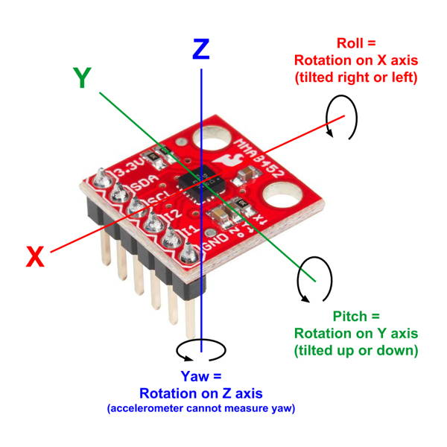
Accelerometer:
Step 1
Step 2
Step 3
Step 4
Step 5
The acceleration generates the force that causes the piezoelectric material to be stressed.
The microscopic crystals structure present in it creates the voltage from the stress.
The accelerometer interprets this voltage.
The voltage is further used to determine the orientation,velocity,
Distance and acceleration.
Three-axis accelerometer gives analog voltage for separate pins, which further can be interpreted as acceleration values or displacement or distance.

Slide 10
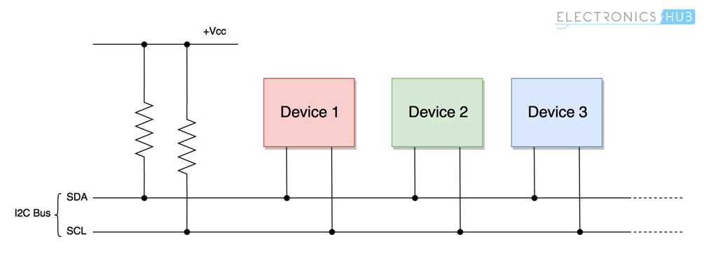

How to read input data with Arduino?

Slide 11
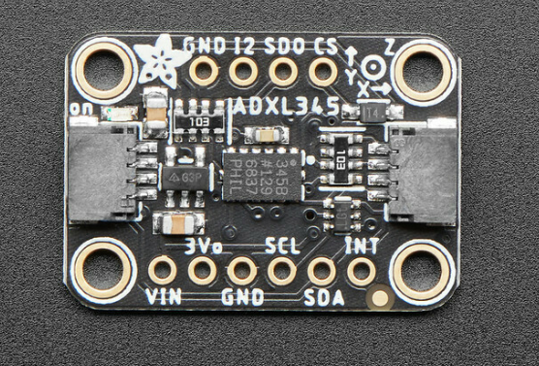
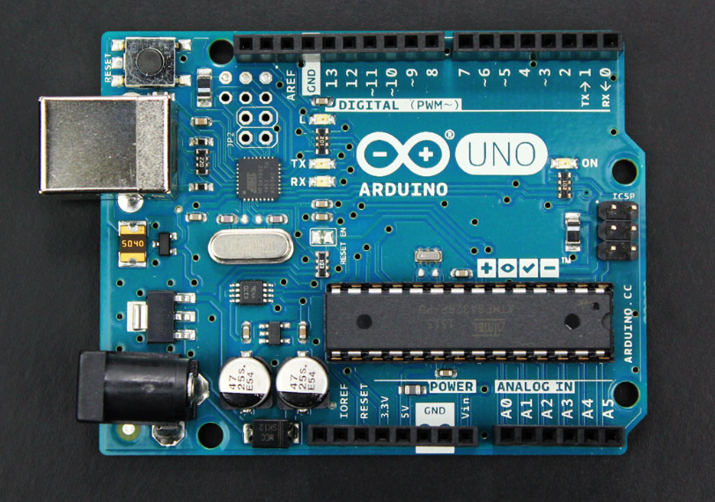

COMMUNICATION
ADXL345 Accelerometer
ARDUINO UNO
Communication
A3->SCL
A2->SDA

Slide 12
ADXL345 Specifications:
Sl.No. | Category | Specifications
1 | Power | Ultra low power: 25 to 130 μA at VS=2.5 V
2 | Scalability | Power consumption scales automatically with bandwidth
3 | Sensitivity | User selectable fixed 10-bit resolution or 4mg/LSB scale factor in all g-ranges, up to 13-bit resolution at ±16g 32 level output data.
4 | Detection Function | Tap/Double Tap detection,Activity/Inactivity monitoring,Free-Fall detection.
5 | Supply I/O voltage Range | 1.8 V to 3.6 V.
6 | Communication | I2C digital interfaces.
7 | Dimensions | Small and thin: 3 × 5 × 1 mm.

Slide 13
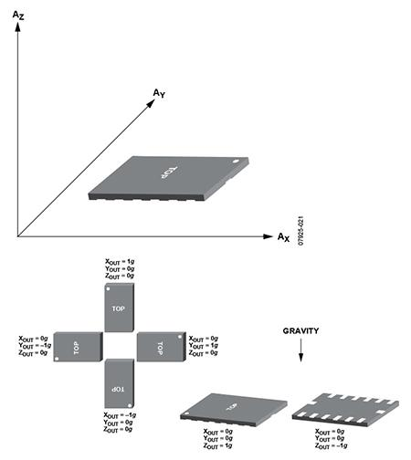
How Does Accelerometer Work?
This is a 3-axis accelerometer which can measure both static and dynamic forces of acceleration.
All accelerometers work on the principle of a mass on a spring.
One of the most commonly used MEMS accelerometer is the capacitive type.
The capacitive MEMS accelerometer is famous for its high sensitivity and its accuracy at high temperatures.

Slide 14
Illustration:
When the sensor is subjected to a linear acceleration along its sensitive axis, the mass and its fingers become displaced.
Gas between the fingers provides a damping effect.
This displacement induces a differential capacitance between the moving and fixed silicon fingers which is proportional to the applied acceleration.

Slide 15
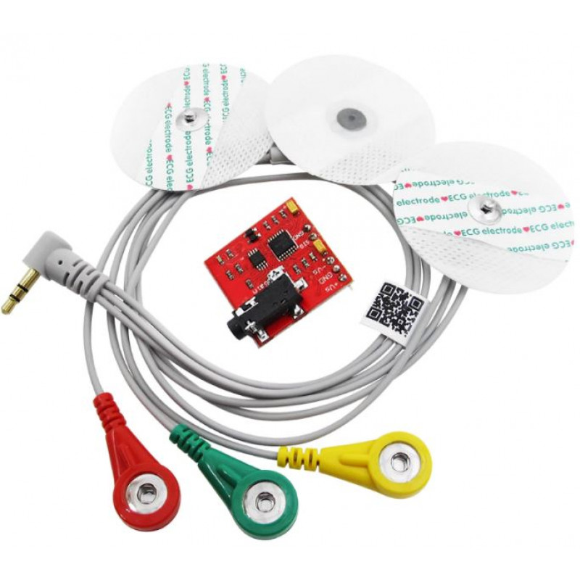
EMG:
Assess the health of muscles and the nerve cells that control them (motor neurons).
EMG results can reveal nerve dysfunction, muscle dysfunction or problems with nerve-to-muscle signal transmission.
Motor neurons transmit electrical signals that cause muscles to contract.
Electrodes are used to transmit signal.

Slide 16
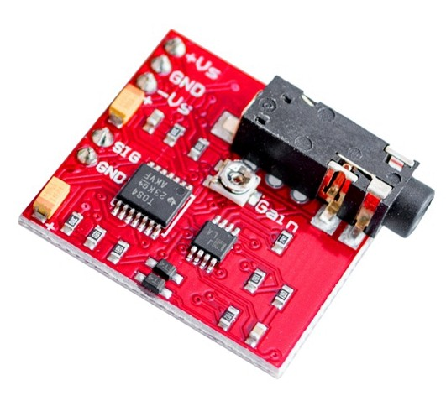
Myoware Sensor
EMG Muscle Sensor Module V3.0 With Cable And Electrodes.
Outputting 0-Vs Volts depending the amount of activity in the selected muscle, where Vs signifies the voltage of the power source.
Power supply voltage: min. +-9.0V.
Supply Current of up to 14mA.

Slide 17
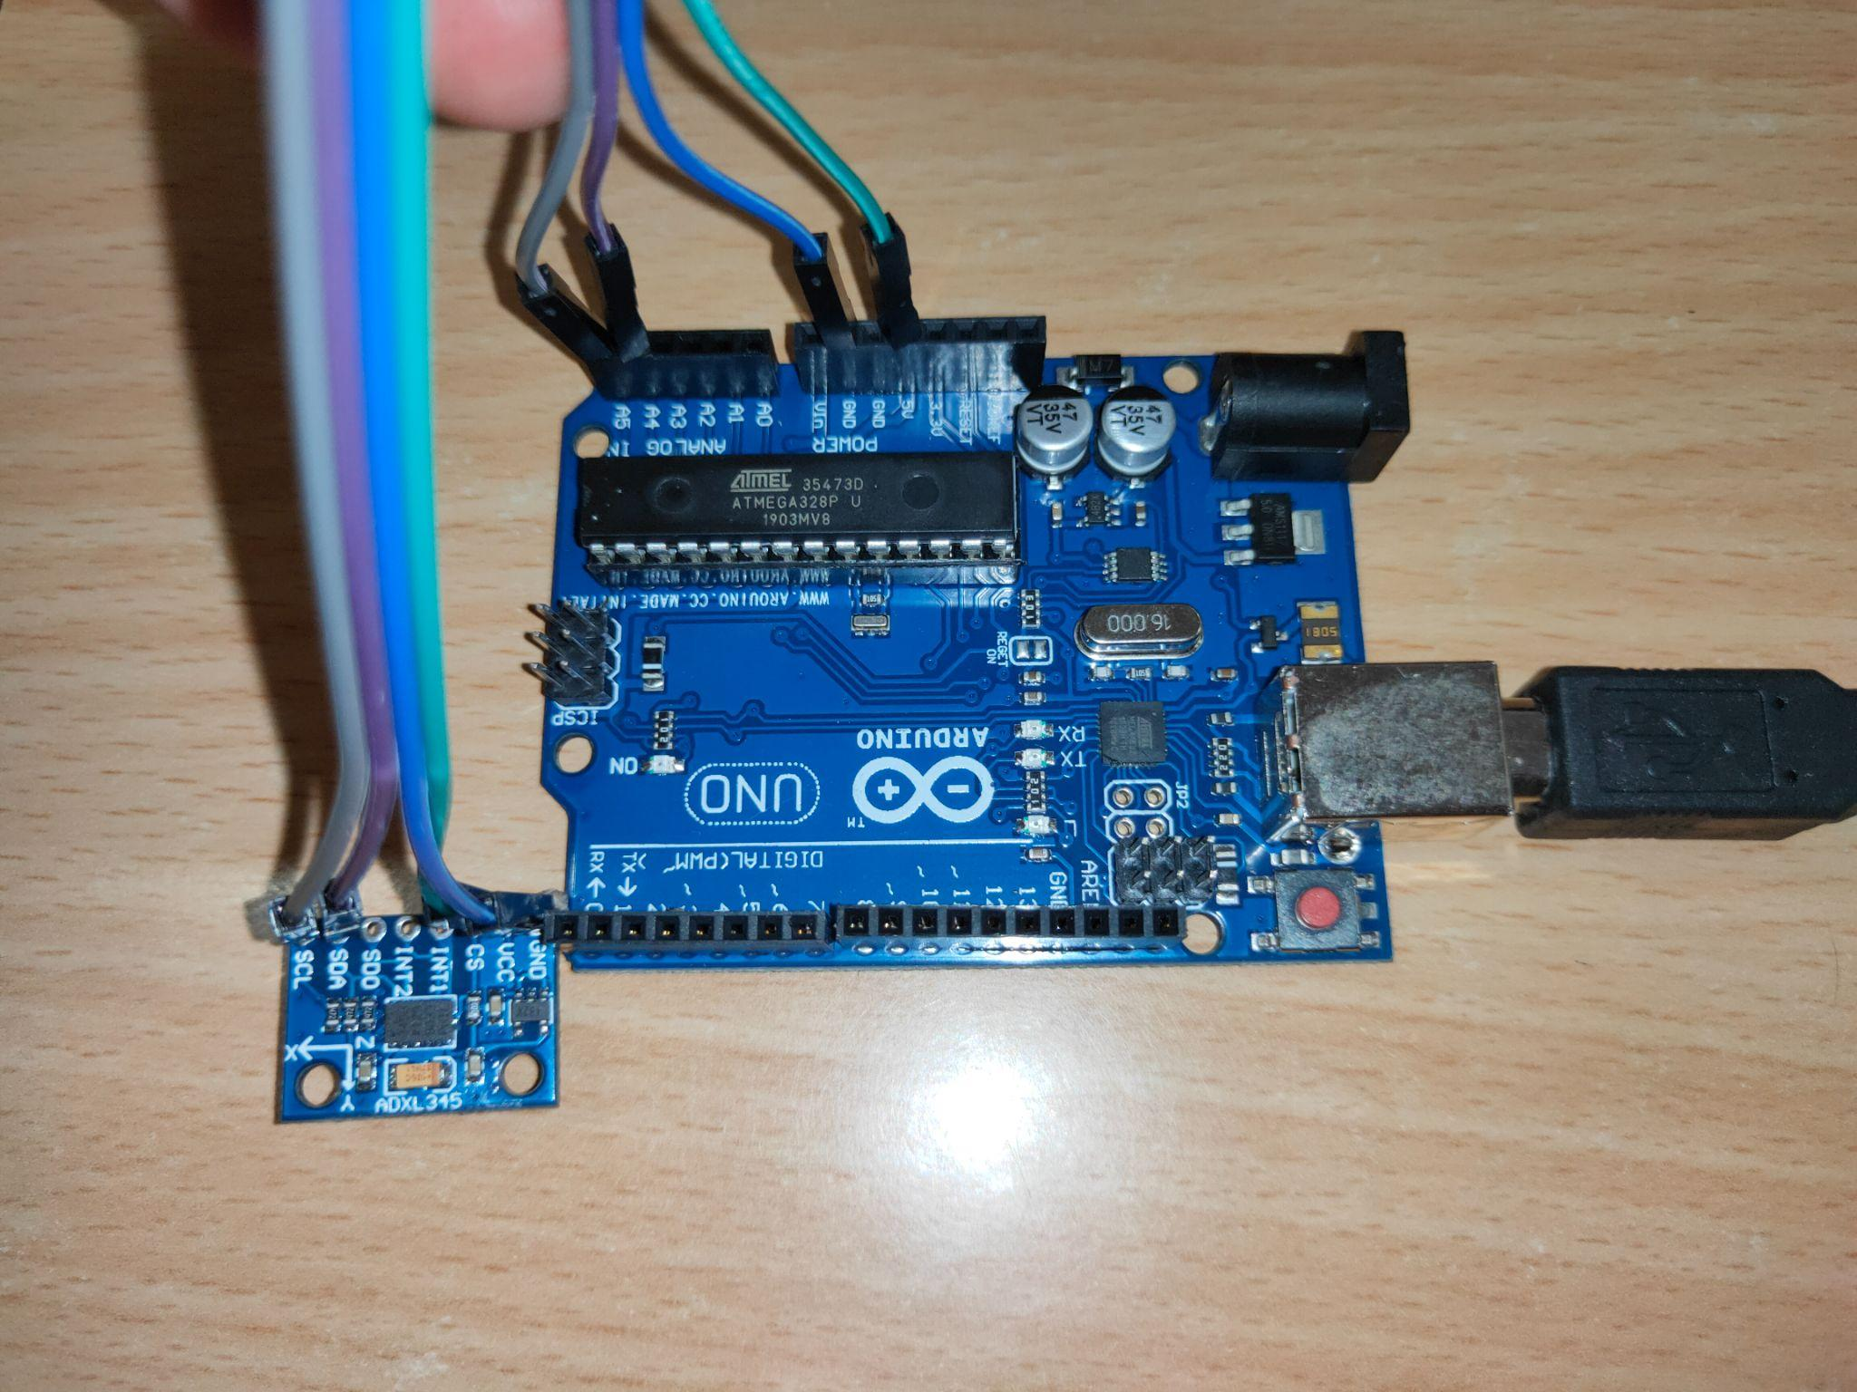
Taking Accelerometer Readings:
Pin Details:
SCL —> A5
SDA —> A4
VCC —> 5V
GND —> GND
We will get acceleration change values in all the three different axes,
according to change in orientation.

Slide 18
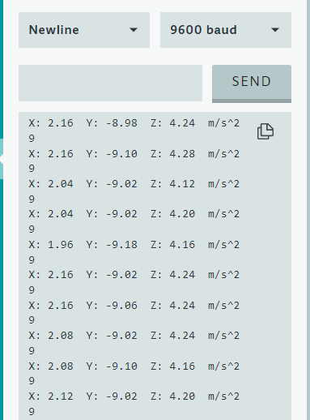
Output Data
Here are the output data from accelerometer.
Every second the different axes values will keep updating.

Slide 19
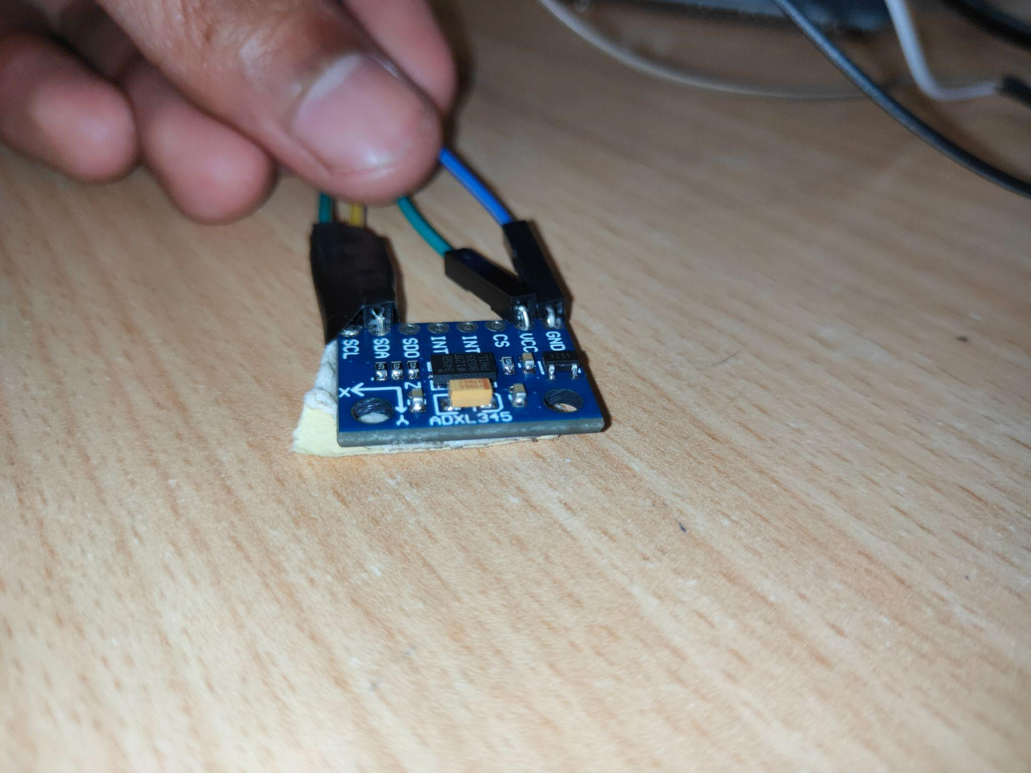
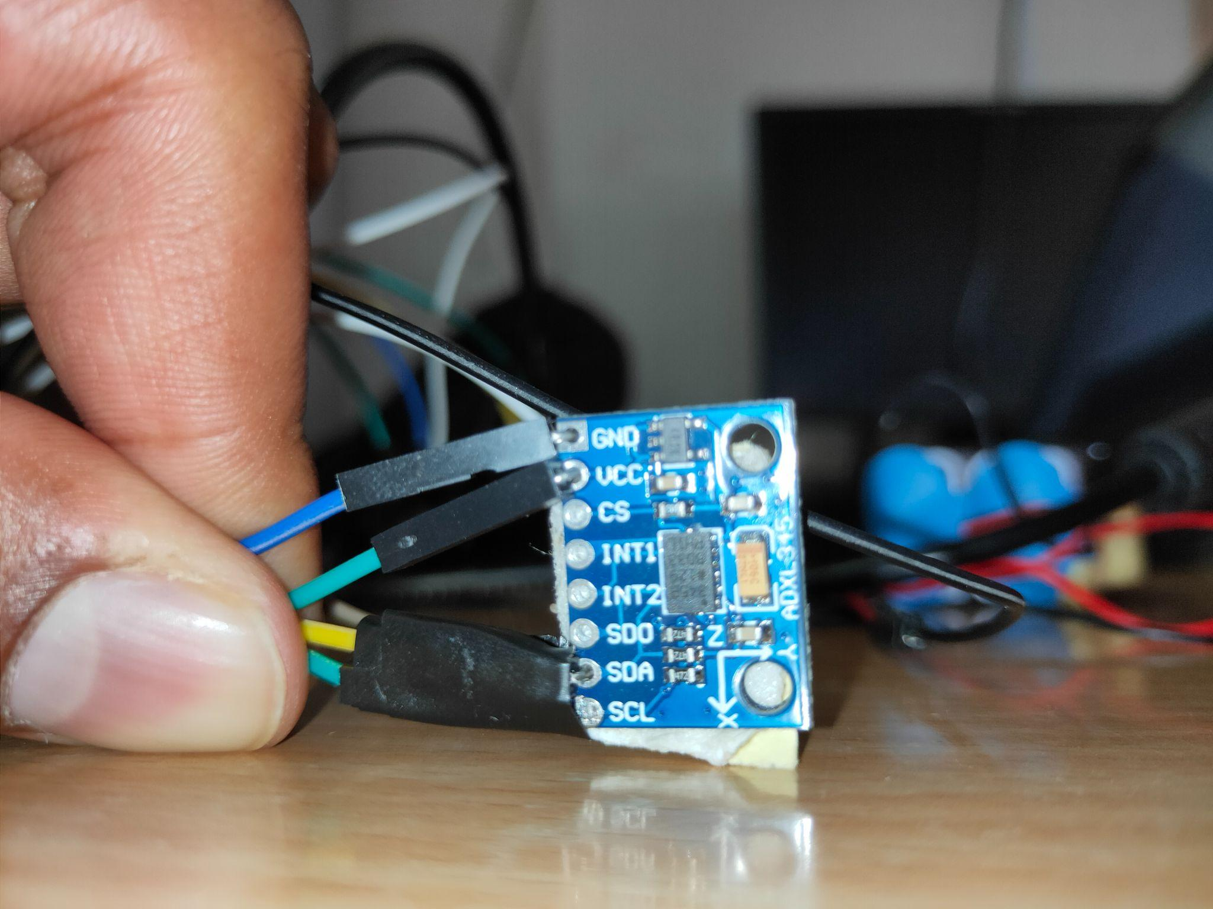
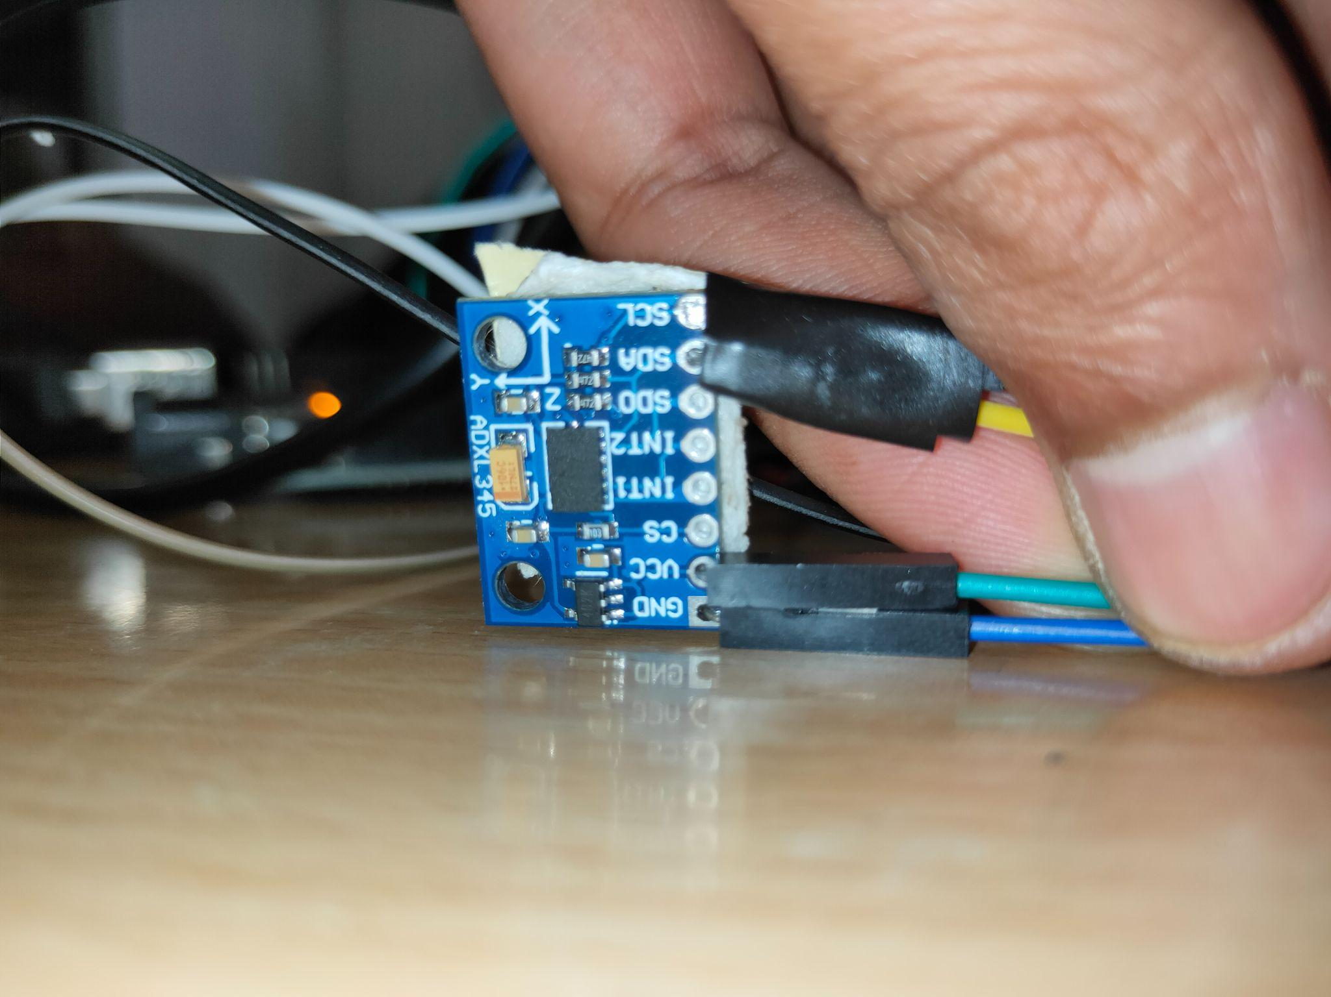
Orientation
X~0g
Y~0g
Z~10g
X~ -10g
Y~0g
Z~10g
X~ +10g
Y~ 0g
Z~10g

Slide 20
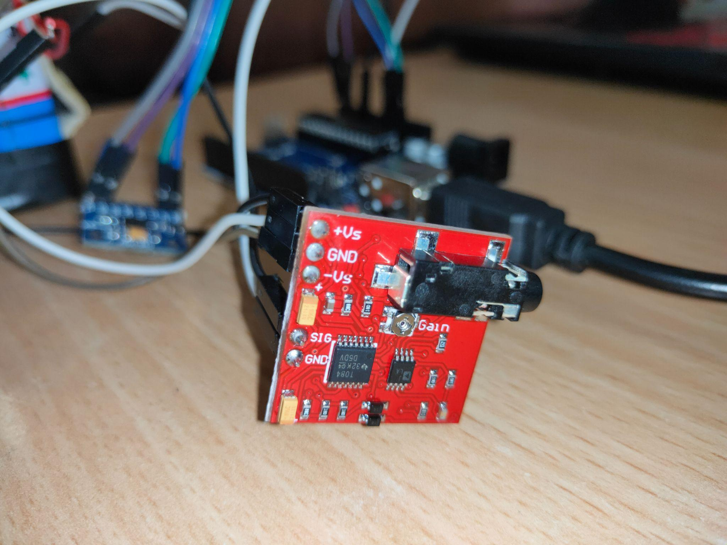
Taking Myoware Readings:
In myoware we are getting the i/p from the analog pin no 0, which is in the range of 0-1023.
0 represents low and 1023 represents high
after that we are converting this range to 0-1 and depending upon the threshold provided for the fatigue we are ensuring the level of fatigue.

Slide 21
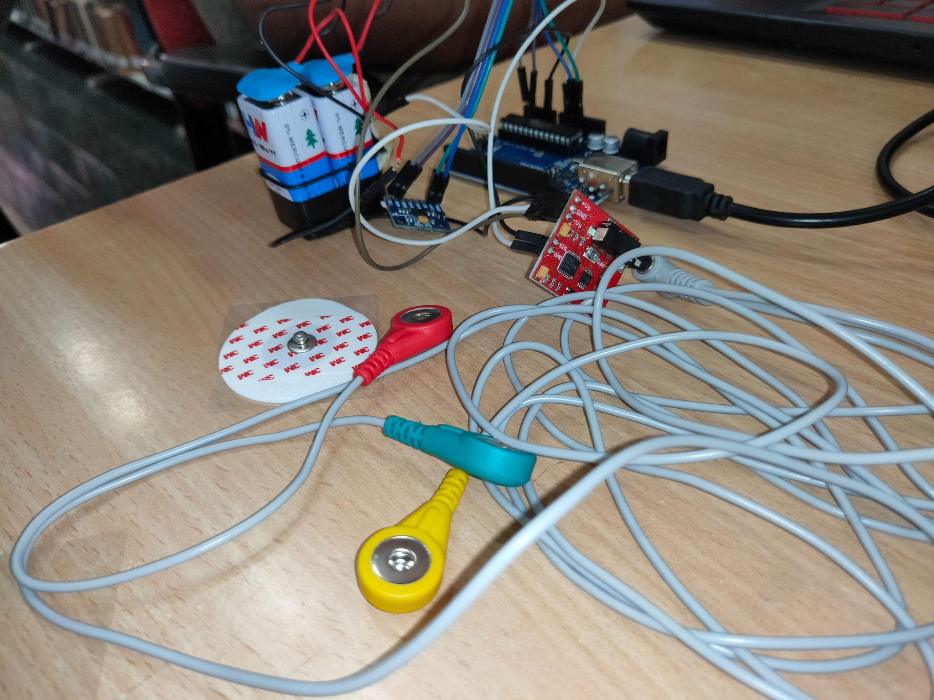
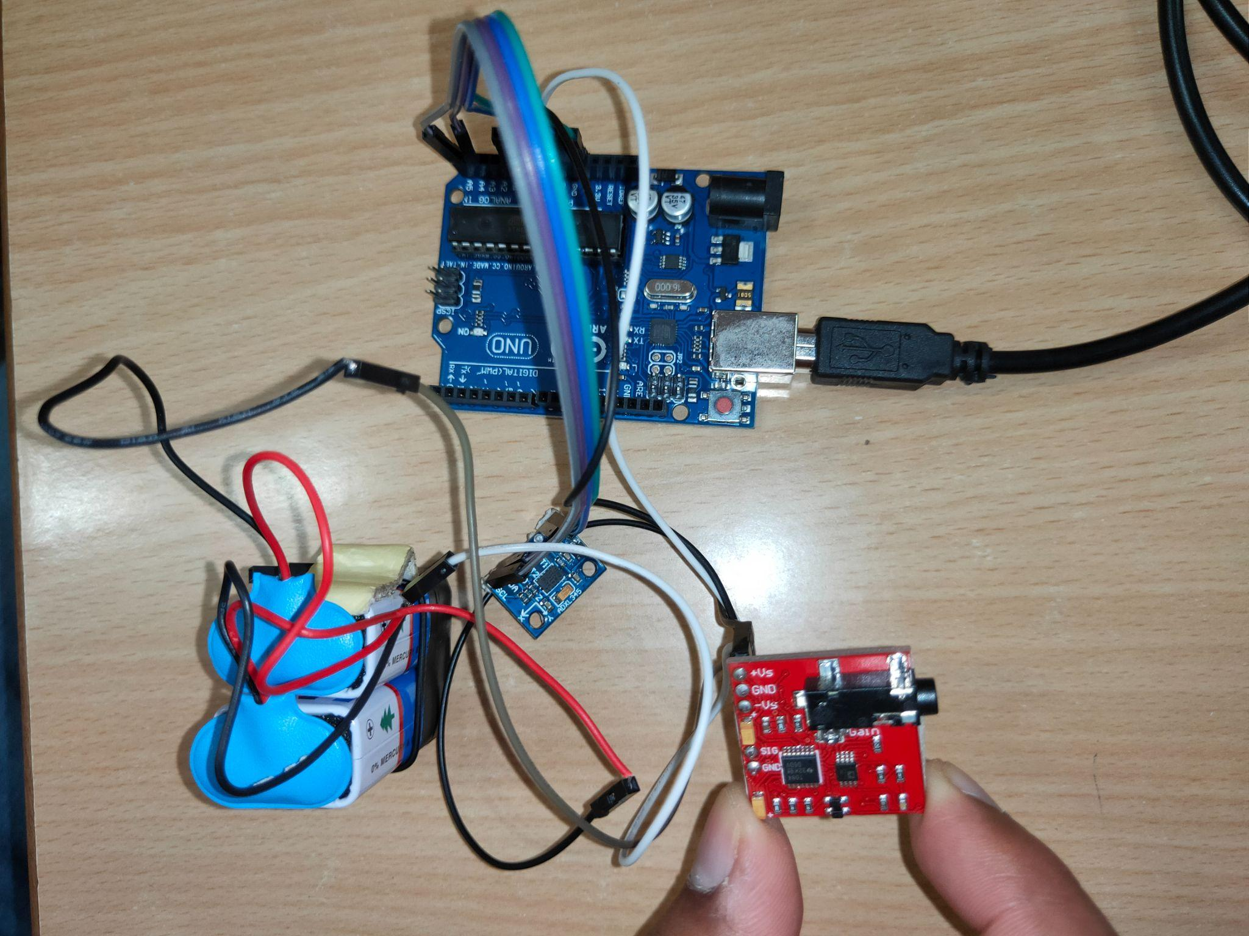
Circuit Connections

Slide 22
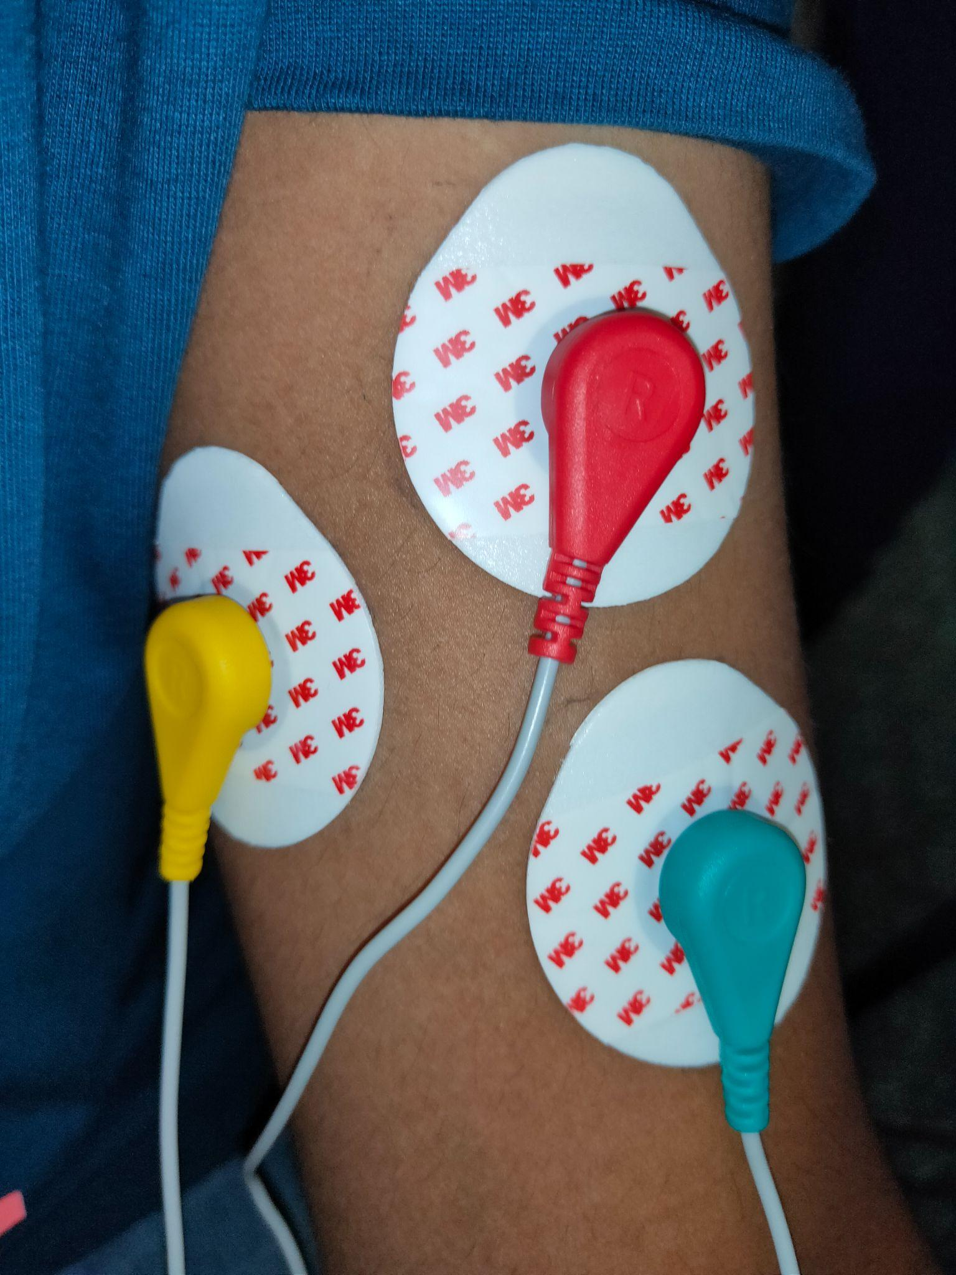
Electrode Placement for biceps
Electrodes are placed in a particular orientation.
Two electrodes are placed axially to each other and one is placed radial to the other two.

Slide 23
Experimental Data Set For Male Candidates:
Name | No. of Repetition | Low fatigue/no fatigue | Fatigue detected
Abhishek | 45 | 0.3-0.47 | 0.47>=
Abhay | 55 | 0.3-0.57 | 0.57>=
Preet | 54 | 0.3-0.51 | 0.51>=
Parth | 60 | 0.3-0.59 | 0.59>=
Ritik | 48 | 0.3-0.51 | 0.51>=
Jai | 56 | 0.3-0.54 | 0.54>=
Danish | 59 | 0.3-0.59 | 0.59>=
Prakhar | 57 | 0.3-0.60 | 0.60>=

Slide 24
Experimental Data Set For Female Candidates:
Name | No. of Repetition | Low fatigue/no fatigue | Fatigue detected
Harshitha | 36 | 0.3-0.40 | 0.40>=
Ambika | 45 | 0.3-0.47 | 0.47>=
Hansa | 40 | 0.3-0.44 | 0.47>=
Gunjan | 43 | 0.3-0.50 | 0.50>=
Pooja | 44 | 0.3-0.52 | 0.52>=
Sonal | 35 | 0.3-0.40 | 0.40>=
Ishita | 46 | 0.3-0.53 | 0.53>=
Vaishnavi | 37 | 0.3-0.42 | 0.42>=

Slide 25
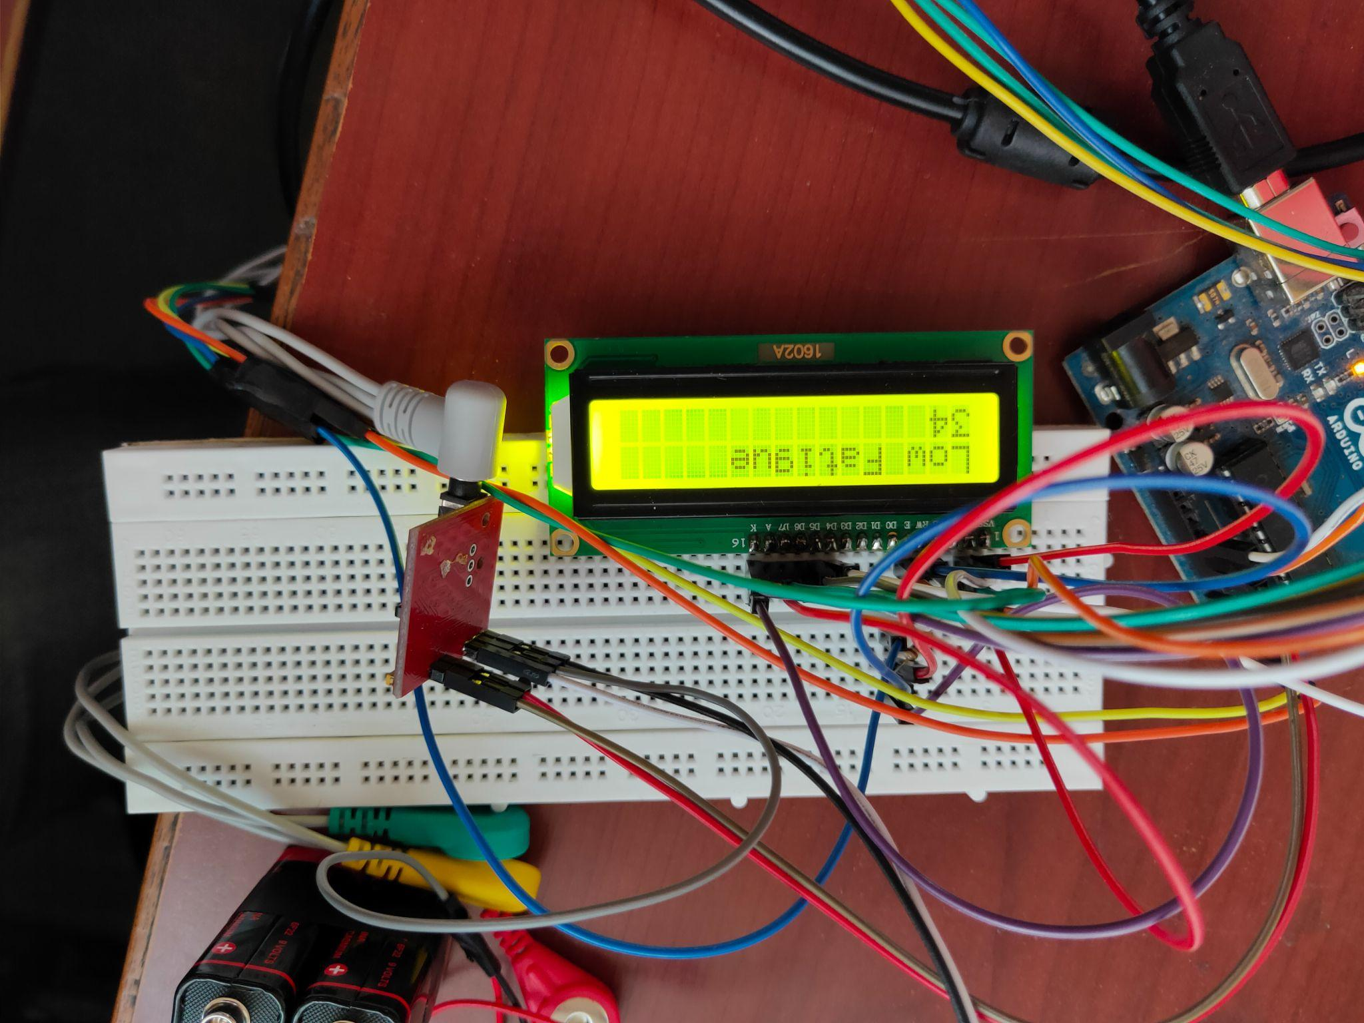
Output Display
On a LCD display we are showing Repetition count and a message which says whether the person has, low, high or medium fatigue.

Slide 26
Conclusion
We are using ADXL345 as our accelerometer module with arduino UNO.
And for the fatigue measurement we are using Myoware type of non-invasive sensor module.

Slide 27
References
Ma, B., Li, C., Wu, Z. et al. Muscle fatigue detection and treatment system driven by internet of things. BMC Med Inform Decis Mak 19, 275 (2019). https://doi.org/10.1186/s12911-019-0982-x
Bourke AK, O'Brien JV, Lyons GM. Evaluation of a threshold-based tri-axial accelerometer fall detection algorithm. Gait Posture. 2007 Jul;26(2):194-9. doi: 10.1016/j.gaitpost.2006.09.012. Epub 2006 Nov 13. PMID: 17101272.
Bourke AK, Lyons GM. A threshold-based fall-detection algorithm using a bi-axial gyroscope sensor. Med Eng Phys. 2008 Jan;30(1):84-90. doi: 10.1016/j.medengphy.2006.12.001. Epub 2007 Jan 11. PMID: 17222579.
M. Ayaz, M. W. Ayub and I. A. Qureshi, "Arduino Based Fatigue Level Measurement in Muscular Activity using RMS Technique," 2020 International Conference on e-Health and Bioengineering (EHB), 2020, pp. 1-4, doi: 10.1109/EHB50910.2020.9280184.
Oliveira AS, Gonçalves M, Cardozo AC, Barbosa FS. Electromyographic fatigue threshold of the biceps brachii muscle during dynamic contraction. Electromyography and Clinical Neurophysiology. 2005 Apr-May;45(3):167-175. PMID: 15981689.
Bourke AK, Lyons GM. A threshold-based fall-detection algorithm using a bi-axial gyroscope sensor. Med Eng Phys. 2008 Jan;30(1):84-90. :10.1016/j.medengphy.2006.12.001. Epub 2007 Jan 11. PMID: 17222579.
Zhao, N., 2010. Full-featured pedometer design realized with 3-axis digital accelerometer. Analog Dialogue, 44(06), pp.1-5.

Slide 28
Thank You!

